Slide 2
The world in which human beings are spiritually enlightened, endowed with the power of pure love & compassion, and also equipped with the judgement and discernment to overcome the differences between men and work together towards a world of peace. Increased agriculture, live stock production through meditation with natural farming to bring about the second Green Revolution.
.
To perpetuate, document and facilitate the spreading of the teachings of Shri Mataji Nirmala Devi and the practice of Sahaja Yoga – a meditation founded by Her, and Sahaj Agriculture in rural areas.

Slide 3
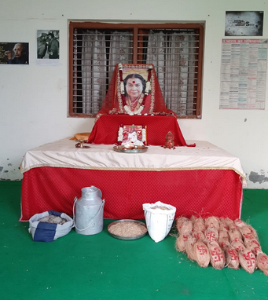
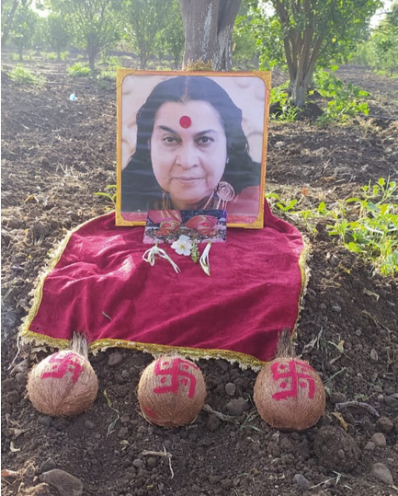
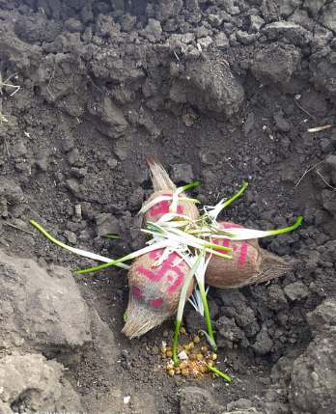
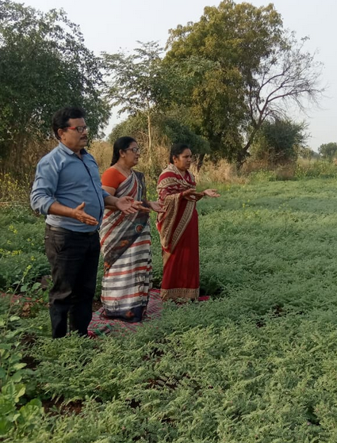
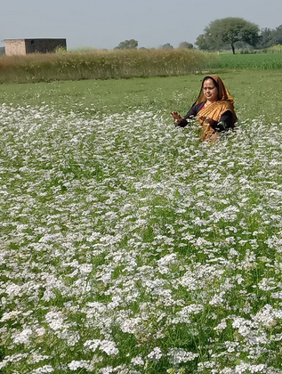
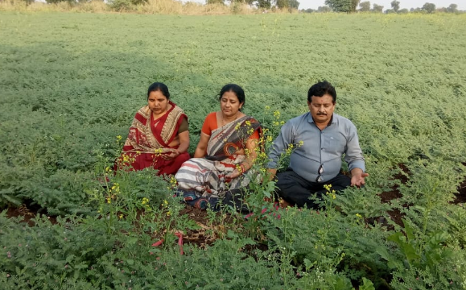
Simple Steps to follow Sahaj Agriculture
STEP I
Learn Sahaja Yoga Meditation, Knowledge of Subtle System, Chakra clearing techniques, Balancing, Manoeuvring Kundalini Shakti
STEP II
Vibrating seeds, water, coconuts by keeping in front of Shri Mataji’s picture overnight. Drawing auspicious Swastik sign on coconut
STEP III
Bhoomi Pujan, Havan, Burying of auspicious vibrated coconut in the fields, using vibrated seeds and water to plant and water the crops respectively.
STEP IV Nourish the growing crops with divine vibrations occasionally. Keep the surroundings vibrated with divine vibrations.

Slide 4
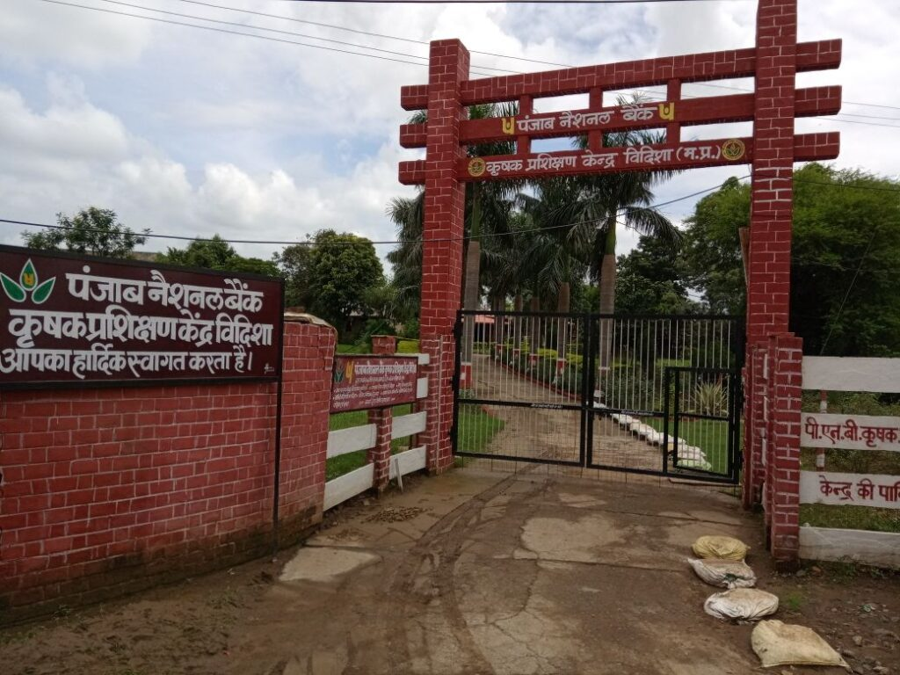
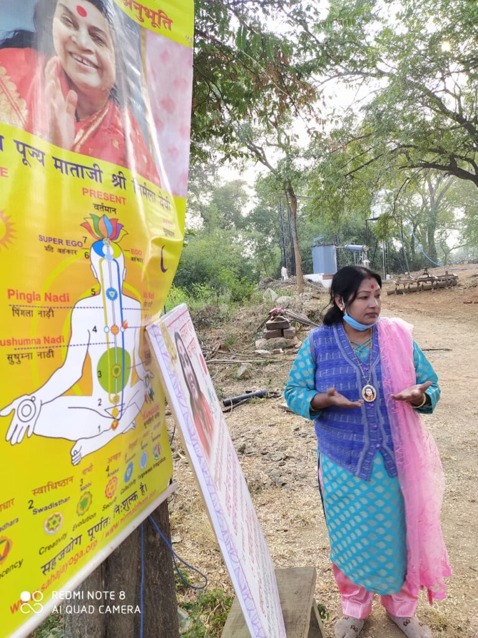
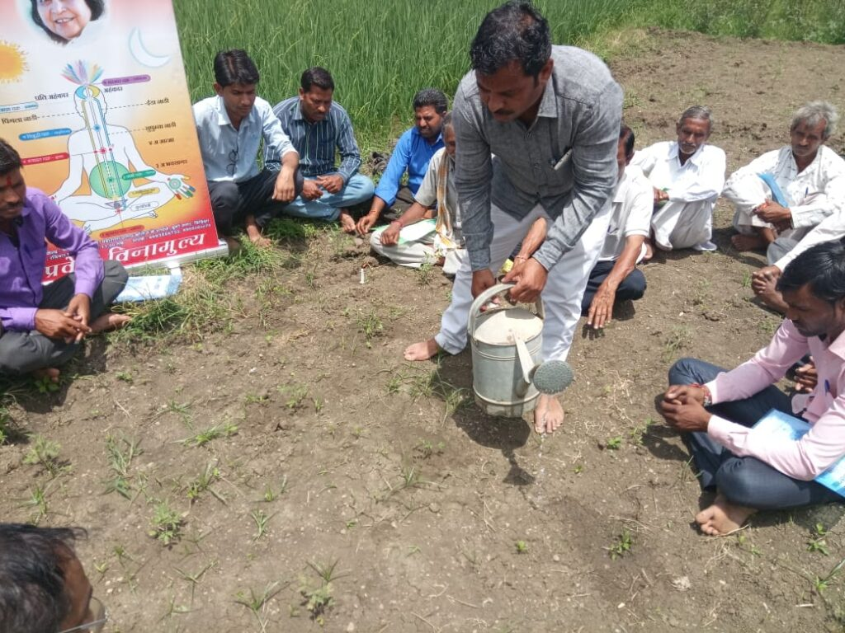
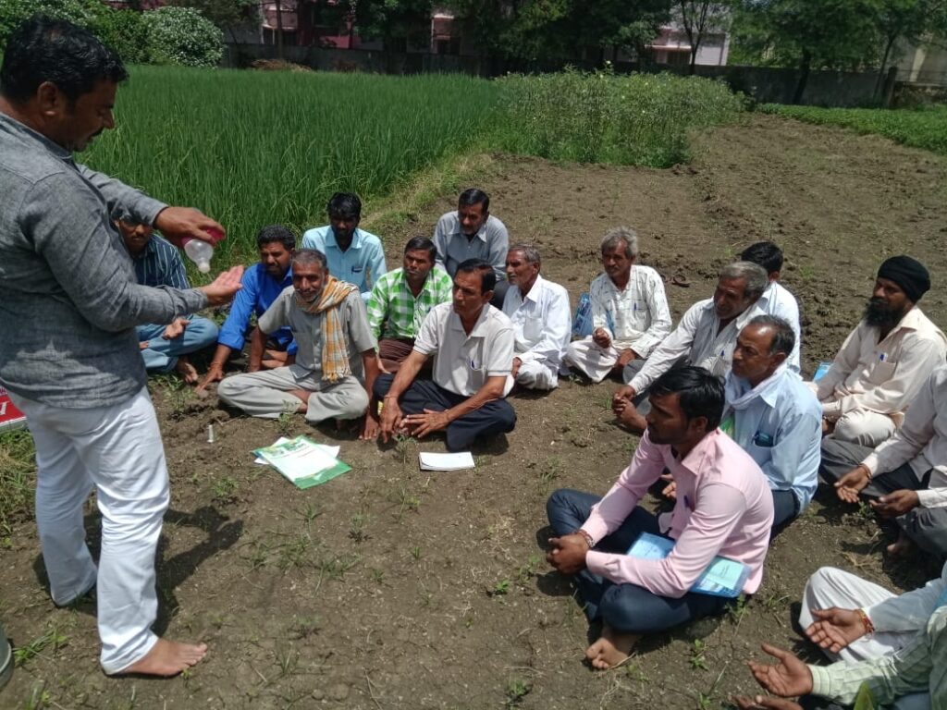
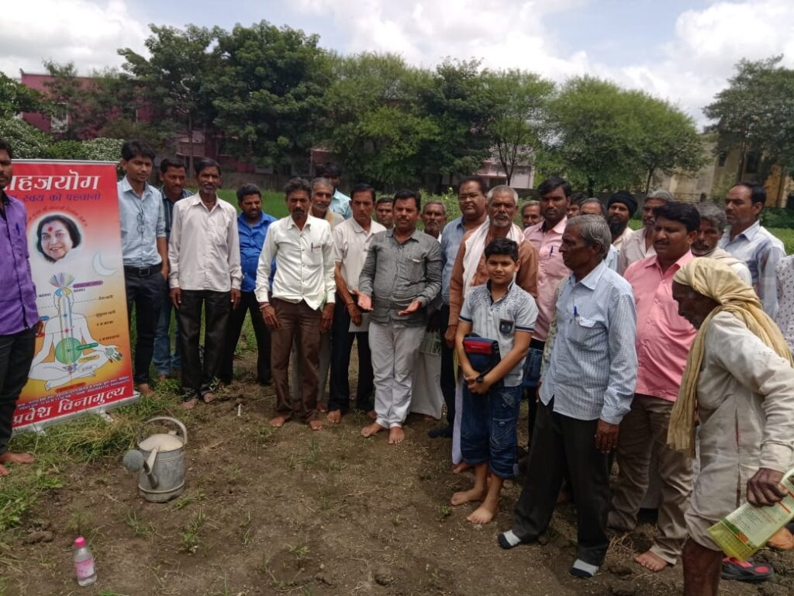
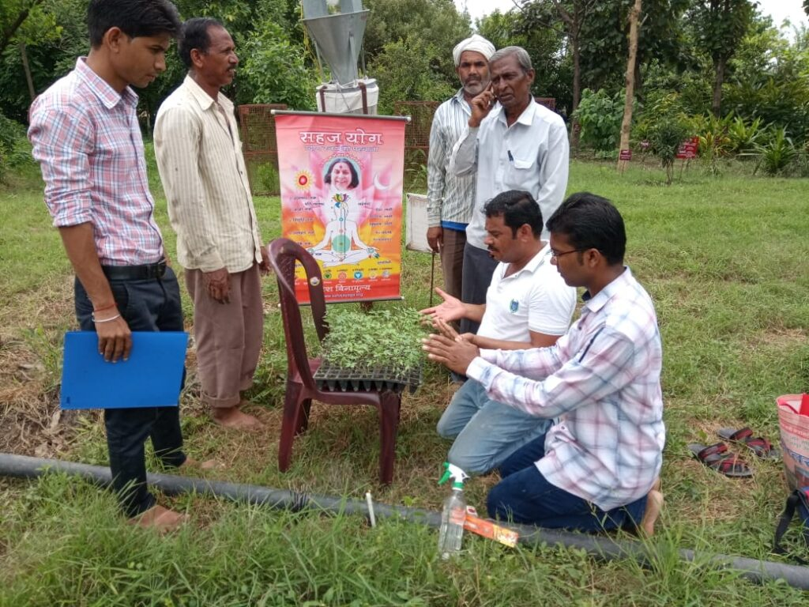
Regular Training on Sahaja Yoga Agriculture Techniques are given to farmers FREE OF COST

Slide 6
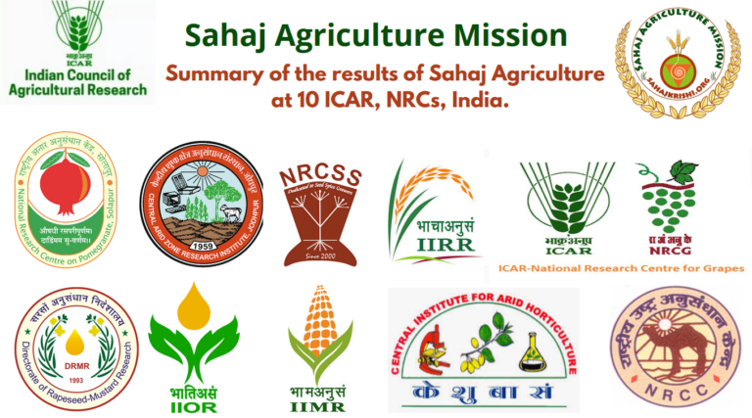

Slide 23
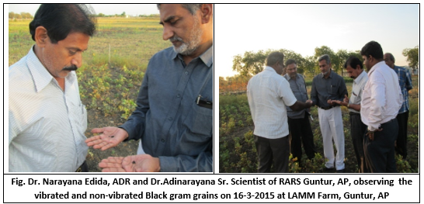
Experiment was conducted under the supervision of Dr. Adinarayana Sr.Scientist, Pulses RARS, LAAM Farm, Guntur, A.P.
a. Results of vibrated Black Gram: LBG-752
Variety: LBG-752
Date of Sowing: 12-12-2014
Plot Size: 6 mt x 6 mt.
Pods Per Plant Vibrated: 22 Pods, non-vibrated Plant:16 Pods.
Total Yield 0.510 Kgs in vibrated a non-vibrated 0.245 kgs from 36 Sq.mt.
Vibrated plants are very healthy and having broad leaves, more chlorophyll content, strong root and uniform growth compare to the non-vibrated plants.
b. Results of vibrated black Gram: LBG-623
Variety: LBG-623
Date of Sowing: 17-7-2014
Plot Size: 6 mt x 6mt.
Observation: LBG-623 is susceptible to Yellow Mosaic Virus but in Vibrated Plot up to 50 days, there was no virus attack.
Uniform growth, healthy plants, good root growth and Bright Green leaves.

Slide 31
In Sahaja Yoga, you take the ordinary seeds and you vibrate them.
If you vibrate them, then what happens that you start getting seeds which are even better than hybrid.
I tried an experiment with a sunflower; so I developed a sunflower about 2 kilo weight, about one foot diameter and such big, big seeds, that you can’t make them out to be sunflower seeds, so the collective was so amazed at it and they felt that this kind of seed will solve all of our oil problem.
Her Holiness Shri Mataji Nirmala Devi
(Shri Ganesha Puja, Madrid, Spain, 6/11/87)

Slide 44
Benefits of
Sahaj
Agriculture
Increased production of food grain
Improved growth of plants/ development
Protection from natural calamities
Improvement in the quality of animal food
Improvement in the health of animals
Improved Immunity
Increase in Milk Production
Know about the effect of the vibrations originating from the divine power on Agriculture, Gardening, Cottage industry and Animal Husbandry
Sahaj Agriculture is based on the principles of Organic Farming.

Slide 45
Visit Website for details – www.sahajkrishi.com (Hindi | www.sahajkrishi/englsih ( English)

